Slide 1

PYTHON APPLICATION PROGRAMMING
Team Python
Department of Computer Science
and Engineering

Slide 2

PYTHON APPLICATION PROGRAMMING
Classes And Objects
Chitra G M
Department of Computer Science and Engineering

Slide 3
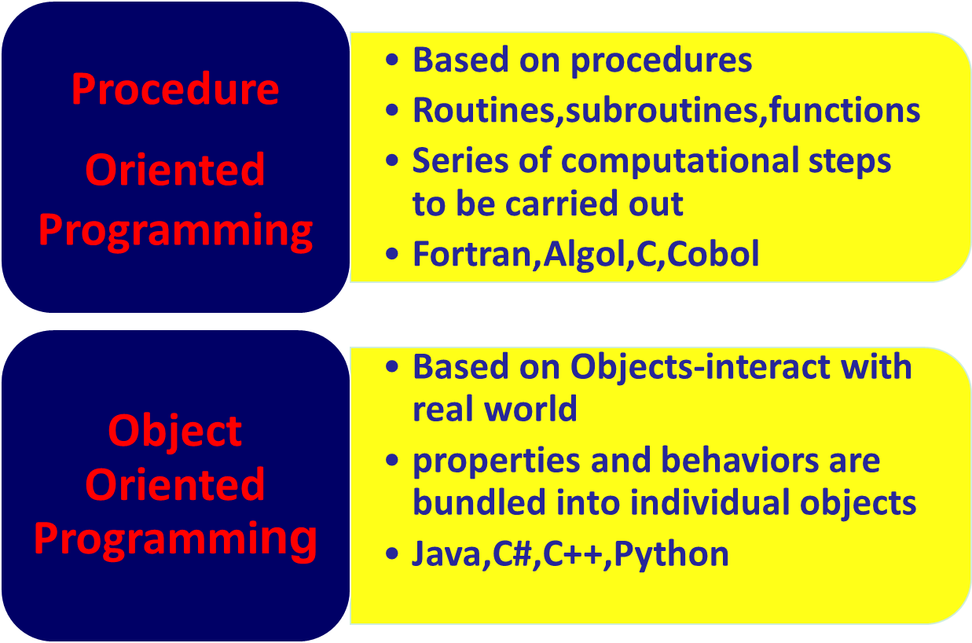
PYTHON FOR COMPUTATIONAL PROBLEM SOLVING
Introduction

Slide 4
PYTHON FOR COMPUTATIONAL PROBLEM SOLVING
Object(1)
Python supports different kinds of data
For Ex:10,10.57,”python”,
[1,5,7,8,9],{“language1”:”Python”,”language2”:”c”}
Each data is considered as an object and each object has
An object has a name that uniquely identifies it
An object has a set of individual properties which make it original, unique or outstanding
An object is an instance of a type.
An object has a set of abilities to perform specific activities, able to change the object itself, or some of the other objects.

Slide 5
PYTHON FOR COMPUTATIONAL PROBLEM SOLVING
Object(1)
Python supports different kinds of data
For Ex:10,10.57,”python”,
[1,5,7,8,9],{“language1”:”Python”,”language2”:”c”}
Each data is considered as an object and each object has
An object has a name that uniquely identifies it
An object has a set of individual properties which make it original, unique or outstanding
An object is an instance of a type.
An object has a set of abilities to perform specific activities, able to change the object itself, or some of the other objects.

Slide 6
PYTHON FOR COMPUTATIONAL PROBLEM SOLVING
Object(2)
There is a hint. Whenever you describe an object you use
a noun – to define the object's name
an adjective –to define the object's property
a verb - to define the object's activity
Example:
Snoopy is a fat dog which eats all day
Object name = Snoopy
Class = Dog
Property = Weight (fat)
Activity = Eat(all day)

Slide 7
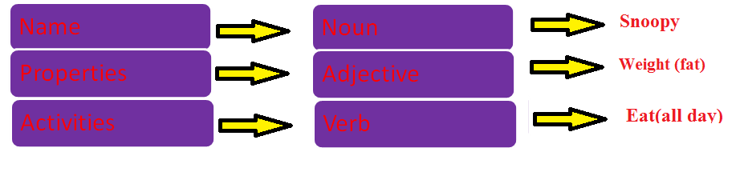
PYTHON FOR COMPUTATIONAL PROBLEM SOLVING
Object(3)

Slide 8
PYTHON FOR COMPUTATIONAL PROBLEM SOLVING
Classes
A language has only a few types namely strings, numbers, lists, tuples, and dictionaries
It can not provide all possible types we may want to have
For example in real life we may want to create a type called as employee,person,table,computer,dog etc
A language should provide a mechanism to make our own type
This can be achieved through a feature called as class

Slide 9
PYTHON FOR COMPUTATIONAL PROBLEM SOLVING
Classes
The simplest form of class definition looks like this
class ClassName:
<statement-1>
.
.
.
<statement-N>

Slide 10
PYTHON FOR COMPUTATIONAL PROBLEM SOLVING
Classes
class student:
pass
print(student, type(student))
Output:
<class '__main__.student'> <class 'type'>
So, student is a type in the package __main__.

Slide 11
PYTHON FOR COMPUTATIONAL PROBLEM SOLVING
Classes
A class can have attributes(fields or variables)
class student: name="abc"
print(student.name)
Output:
abc
A class can have functions(behaviour)
A class can have behavior
class student:
name="abc"
def abc():
print(“student abc")
student.abc()
Output:
student abc

Slide 12
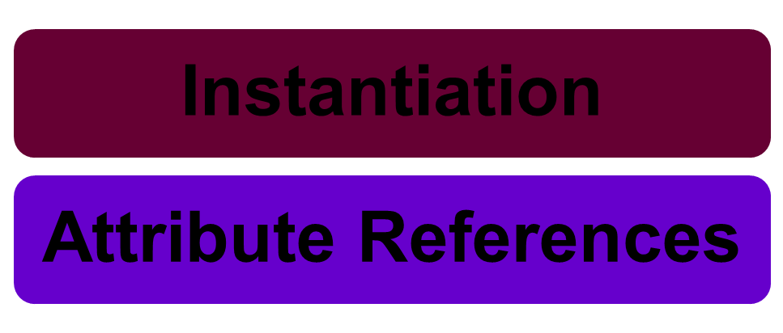
PYTHON FOR COMPUTATIONAL PROBLEM SOLVING
Classes
Classes support two kinds of operations
A class can have behavior

Slide 13
PYTHON FOR COMPUTATIONAL PROBLEM SOLVING
Classes
Creating a variables of a given type(student)is called as instantiation
class student:
pass
a = student()
print(a, type(a))
Output:
<__main__.student object at 0x7fdb9d725e48>
<class '__main__.student'>

Slide 14
PYTHON FOR COMPUTATIONAL PROBLEM SOLVING
Classes
a = student() conceptually becomes student.__init__(a)
The instance is passed as the frst argument to the constructor.
Even though the argument is implicit, in Python, we require an explicit parameter
This can be given any name - is normally called self

Slide 15
PYTHON FOR COMPUTATIONAL PROBLEM SOLVING
Classes
class abc:
def __init__(self):
print("constructor called")
print('self : ', self)
a = abc()
print('a : ', a)
Output:
constructor called
self : <__main__.abc object at 0x7f43d4e87860>
a : <__main__.abc object at 0x7f43d4e87860>

Slide 16
PYTHON FOR COMPUTATIONAL PROBLEM SOLVING
Classes
An object can have attributes
Normally added and initialized in the constructor
Attribute references use dot notation to access attributes associated with the class
class Rect:
def __init__(self, l, b):
self.length = l
self.breadth = b
# print(length)
# error
# all names should be fully qualifed
print("__init__", self.length, self.breadth)
# initialize a Rect object r1 with length 20 and breadth 10
r1 = Rect(20, 10)
print(r1.length, r1.breadth)

Slide 17
PYTHON FOR COMPUTATIONAL PROBLEM SOLVING
Classes
Output:
__init__ 20 10
20 10
Attributes can be accessed any where with a fully qualifed name
Can create any number of objects
Constructors are invoked to initialize them

Slide 18
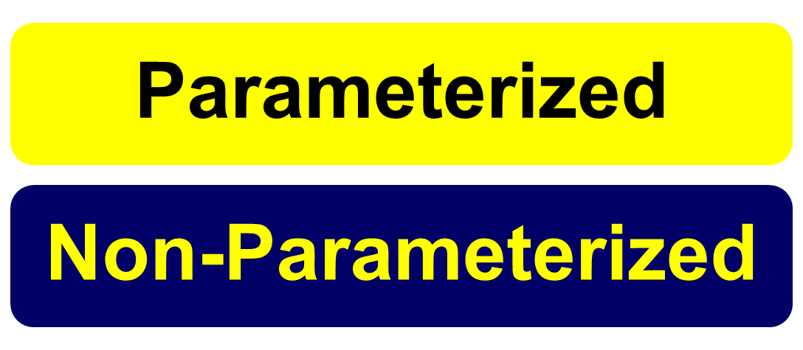
There are 2 types of constructors namely
There are 2 types of constructors namely
There are 2 types of constructors namely
There are 2 types of constructors namely
PYTHON FOR COMPUTATIONAL PROBLEM SOLVING
Constructors
There are 2 types of constructors namely

Slide 19
There are 2 types of constructors namely
There are 2 types of constructors namely
There are 2 types of constructors namely
There are 2 types of constructors namely
PYTHON FOR COMPUTATIONAL PROBLEM SOLVING
Constructors
Non - Parameterized Constructor
When no parameters are passed for invoking constructor
class Person:
def __init__(self)
print("without parameters")
p= Person()
Output:
without parameters

Slide 20
There are 2 types of constructors namely
There are 2 types of constructors namely
There are 2 types of constructors namely
There are 2 types of constructors namely
PYTHON FOR COMPUTATIONAL PROBLEM SOLVING
Constructors
Parameterized Constructor
Parameters are passed for invoking the constructor
class Person:
def __init__(self,name,age):
self.name = name
self.age = age
def display(self):
print(self.name,self.age)
p = Person("joe",30)
p.display()
Output:
joe 30

Slide 21
Instance variables are for data unique to each instance and class variables are for attributes and methods shared by all instances of the class.
There are 2 types of constructors namely
There are 2 types of constructors namely
There are 2 types of constructors namely
There are 2 types of constructors namely
PYTHON FOR COMPUTATIONAL PROBLEM SOLVING
Class And Instance Variables
Instance variables are for data unique to each instance
Class variables are for attributes and methods shared by all
instances of the class.
class Animal:
kind = 'dog' # class variable shared by all instances
def __init__(self, name):
self.name = name # instance variable unique to each instance
a= Animal('pinky')
b = Animal('snow')
print( a.kind ) # shared by all dogs
print( b.kind ) # shared by all dogs
print( a.name) # unique to a
print( b.name ) # unique to b
dog
pinky
snow

Slide 22
THANK YOU
Team Python*
Department of Computer Science and Engineering
Contact Email ID’s:
chitragm@pes.edu

